Slide 1
ECE686 PROJECT: Simulation-Based Policy Gradient And Its Application FOR OFFICE BUILDING HVAC
Nurken TUKTIBAYEV, MEng student
Electrical and Computer Engineering,
University of Waterloo, Winter 2019

Slide 2



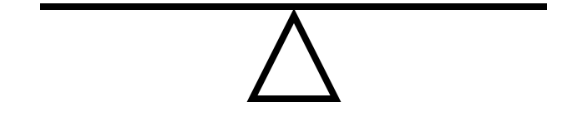
MOTIVATION
HVAC (Heating, Ventilation, and Air Conditioning) is an important application of stochastic control systems.
The main goal is to balance between consumption of the energy and comfort of the occupants in work environments.
Fig. 1. Electrical bill [1]
Fig. 2. Temperature feeling [2]

Slide 3

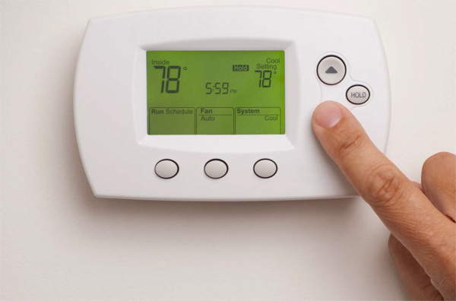
MOTIVATION
HVAC control system disturbed by the noises, such as outdoor air temperature, solar radiation, and occupant interactions.
In particular, occupant’s choice of the setpoint usually influenced by the room temperature, which makes state and noise variables to be interdependent.
In this case existing approaches, such as stochastic Model Predictive Control (MPC) or Approximate Dynamic Programming (ADP) methods, cannot be applied to design an optimal control.
Fig. 3. Weather [3]
Fig. 4. Climate control [4]

Slide 4
INTRODUCTION
This project is based on the following paper:
Lee, Donghwan ; Lee, Seungjae ; Karava, Panagiota ; Hu, Jianghai “Simulation-Based Policy Gradient and Its Building Control Application” 2018 Annual American Control Conference (ACC), June 2018, pp.5424-5429
It applies stochastic simulation-based policy gradient method for optimal office building HVAC control system:
Approximates the gradient of the cost function using simulations
Uses a gradient descent type algorithm to design a suboptimal control policy
Assesses its performance through a simulation of building HVAC system
Compares this method to the finite-horizon LQR state-feedback control policy

Slide 5
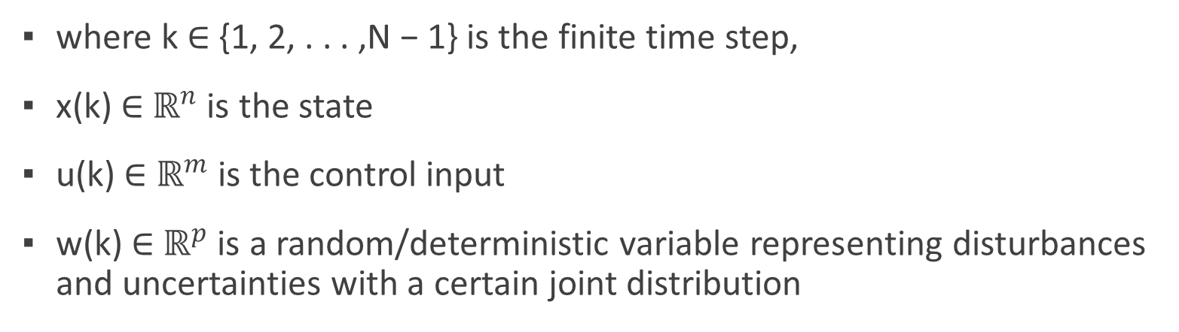
Discrete-time stochastic system
where k ∈ {1, 2, . . . ,N − 1} is the finite time step,
x(k) ∈ $ℝ^{n}$ is the state
u(k) ∈ $ℝ^{m}$ is the control input
w(k) ∈ $ℝ^{p}$ is a random/deterministic variable representing disturbances and uncertainties with a certain joint distribution

Slide 6
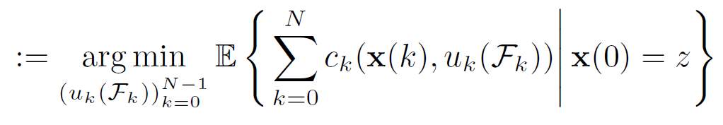
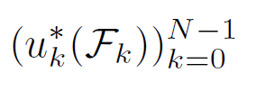
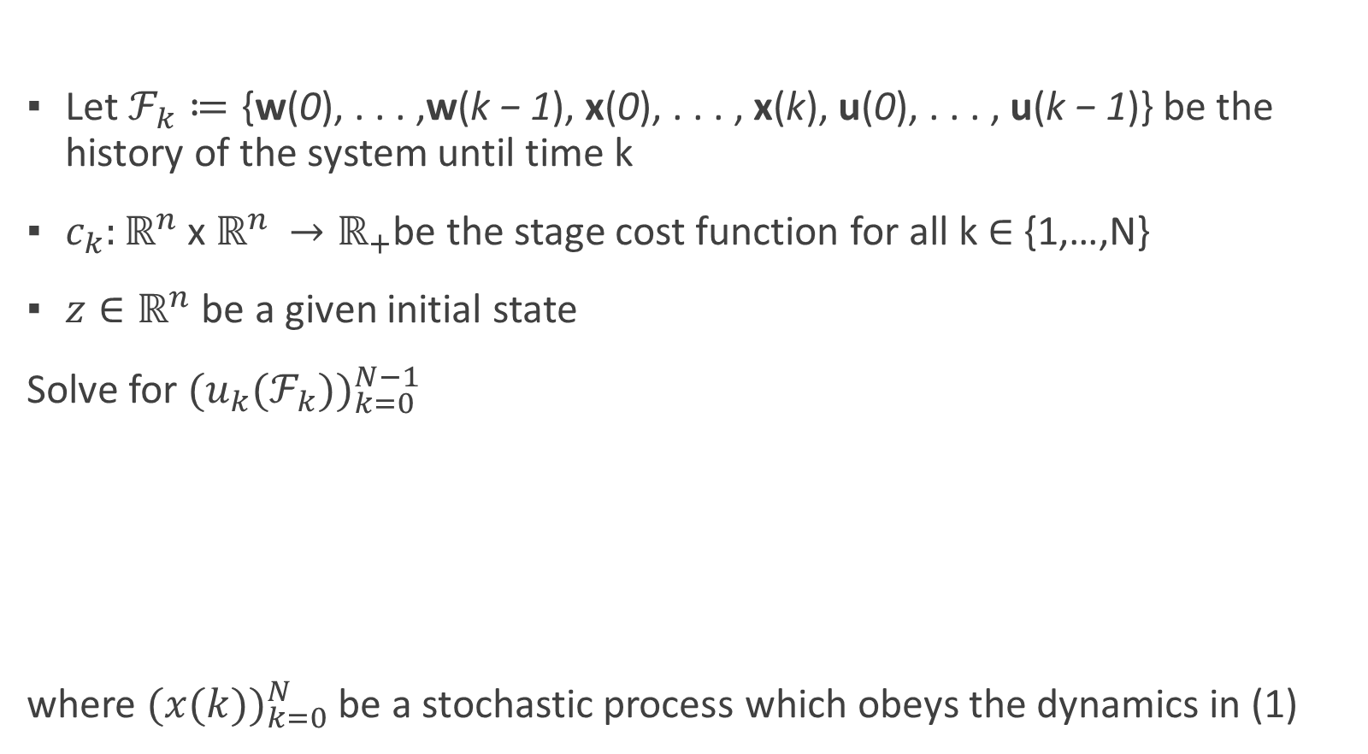
Problem 1 optimal control problem (OCP)
Let $ℱ_{k}≔\text{\{}\text{w}\text{(}\text{0}\text{), . . . ,}\text{w}\text{(}\text{k}\text{ − 1}\text{), }\text{x}\text{(}\text{0}\text{),} \text{. . . , }\text{x}\text{(}\text{k}\text{), }\text{u}\text{(}\text{0}\text{), . . . , }\text{u}\text{(}\text{k}\text{ − 1}\text{)\}}$ be the history of the system until time k
$c_{k}:ℝ^{n}$ x $ℝ^{n }→ℝ_{+}$be the stage cost function for all k ∈ {1,…,N}
${z∈ℝ}^{n}$ be a given initial state
Solve for ${(u}_{k}{{(ℱ}_{k}))}_{k=0}^{N−1}$
where ${(x(k))}_{k=0}^{N}$ be a stochastic process which obeys the dynamics in (1)
Notes:
Has many applications
Includes general stochastic systems
Cannot be solved by existing stochastic techniques (e.g. MPC)

Slide 7
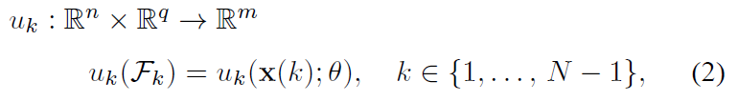
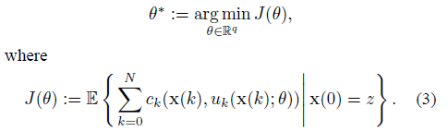
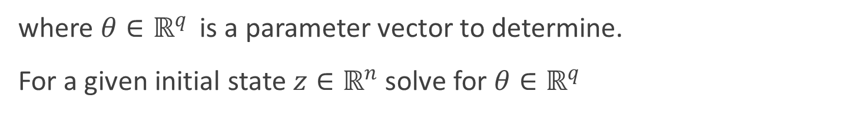
Problem 2 Simplified optimal control problem
Consider the parameterized state-feedback policy
where ${θ∈ℝ}^{q }$ is a parameter vector to determine.
For a given initial state ${z∈ℝ}^{n}$ solve for ${θ∈ℝ}^{q }$
Notes:
Approximation or Problem 1
If gradient of J($θ$) exists, it is difficult to compute it
In many practical applications, J is not smooth, and for some ${θ∈ℝ}^{q }$ the gradient ${J(θ)}^{ }$ does not exist

Slide 8
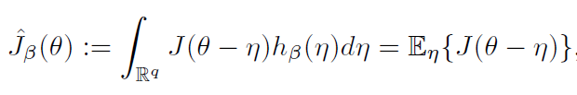
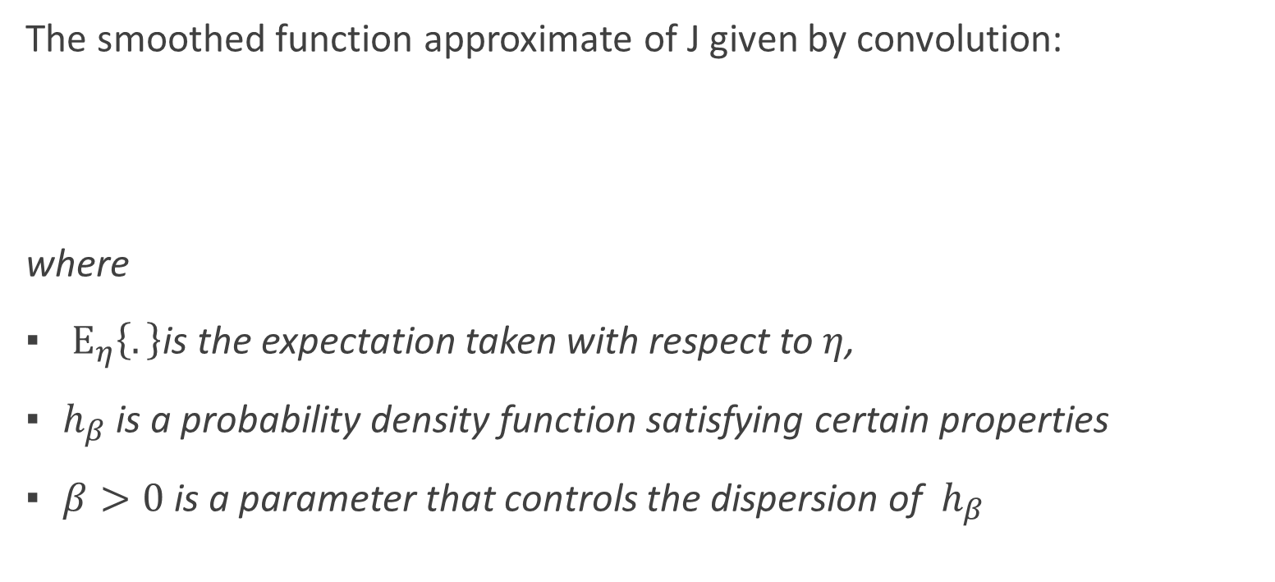
Smoothing and stochastic approximation
The smoothed function approximate of J given by convolution:
where
$Ε_{η}\left\{.\right\}$is the expectation taken with respect to $η$,
$h_{β}$ is a probability density function satisfying certain properties
$β>0$ is a parameter that controls the dispersion of $h_{β}$
Notes:
$\hat{J}\left(θ\right)\left(J hat\right)$is differentiable even when $J(θ)$is not
For a sufficiently large $β$, $\hat{J}(θ)$becomes convex
For sufficiently small $β$, $\hat{J}(θ)$ approximates $J(θ)$with arbitrary small errors

Slide 9
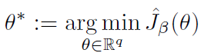
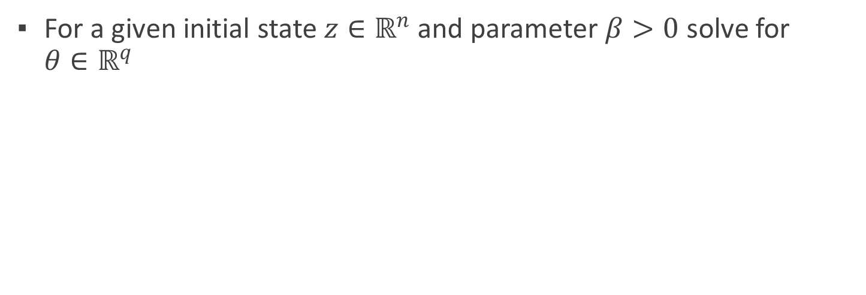

Problem 3 $β$approximated socp
For a given initial state ${z∈ℝ}^{n}$ and parameter $β>0$ solve for ${θ∈ℝ}^{q }$

Slide 10
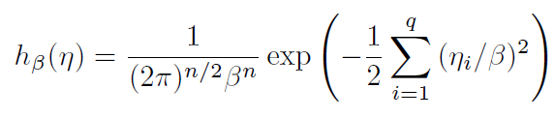
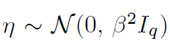
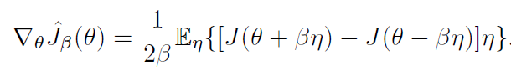
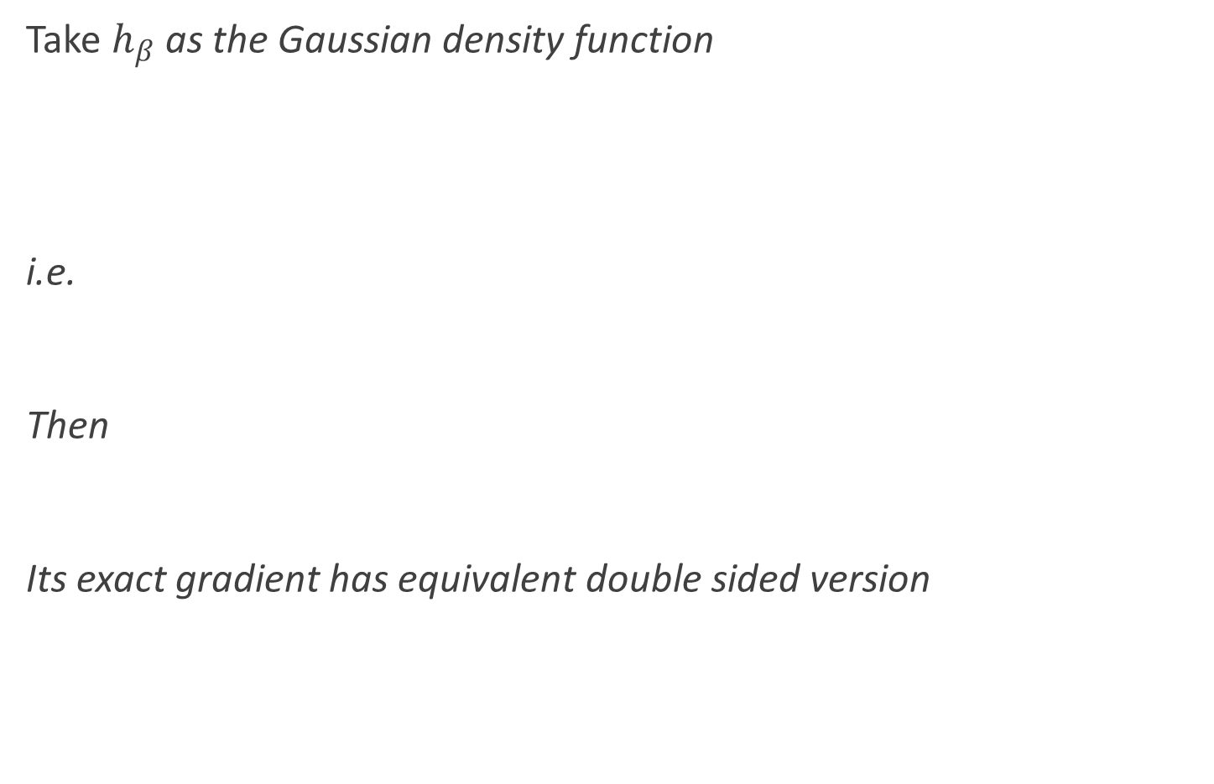
Gradient estimate
Take $h_{β}$ as the Gaussian density function
i.e.
Then
Its exact gradient has equivalent double sided version

Slide 11
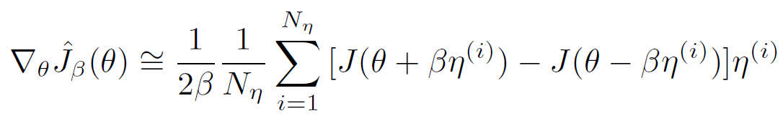
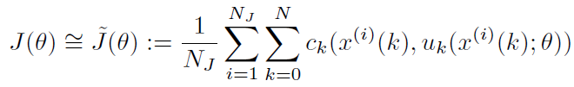
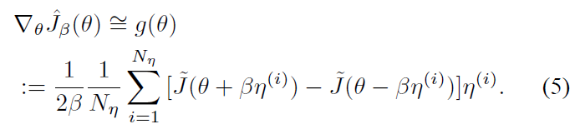
Gradient estimate
Using stochastic gradient estimate we get
Using the sample average
Finally we get our gradient estimator:
Notes:
Computation of the expectation is
numerically intractable

Slide 12
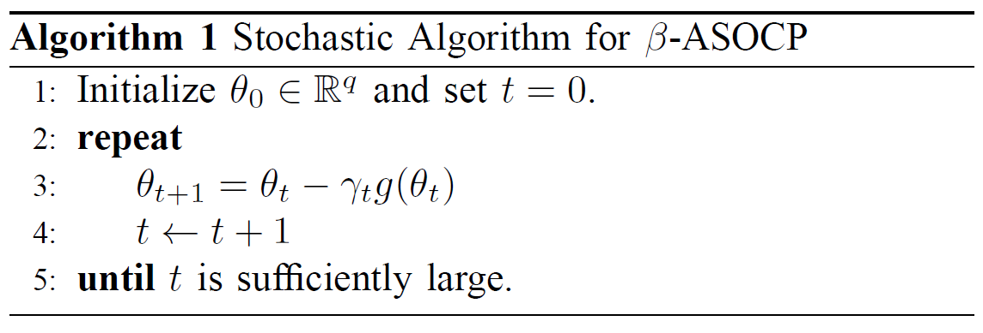

STOCHASTIC ALGORITHM FOR $β−ASOCP$
A gradient descent type algorithm can be used to solve Problem 3:

Slide 13
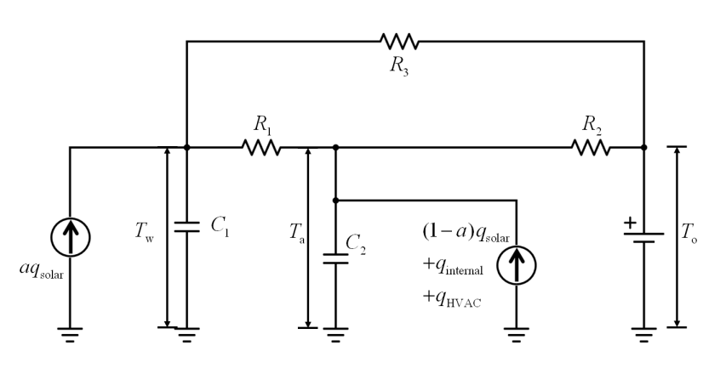
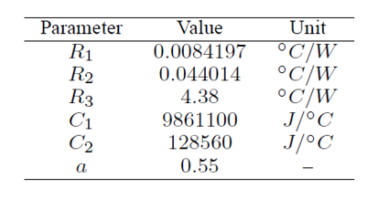
BUILDING HVAC SYSTEM CONTROL
Consider a 3m×3m private office space with a 2.5m2 south facing window
Fig. 5. RC circuit analogy (left) and values of its parameters (right) [5]

Slide 14
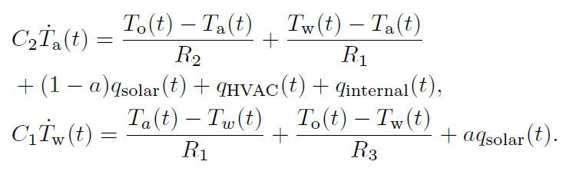
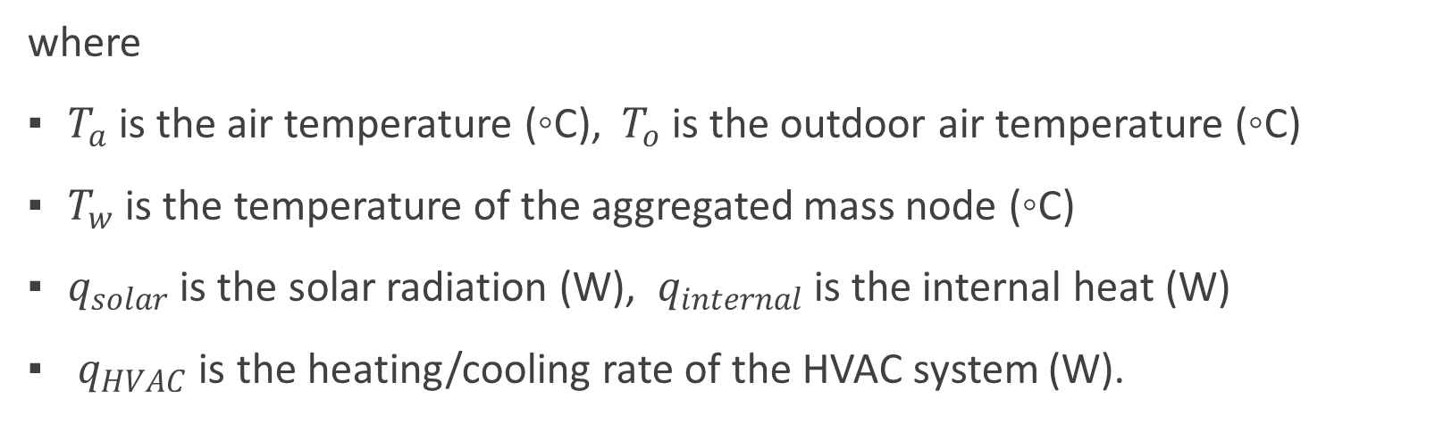
The dynamic SYSTEM model
where
$T_{a}$is the air temperature (◦C), $T_{o}$is the outdoor air temperature (◦C)
$T_{w}$ is the temperature of the aggregated mass node (◦C)
$q_{solar}$ is the solar radiation (W), $q_{internal}$ is the internal heat (W)
$q_{HVAC}$ is the heating/cooling rate of the HVAC system (W).

Slide 15
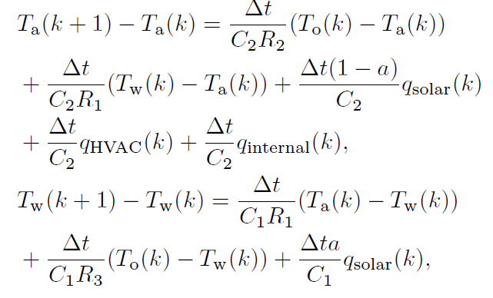
A discrete time representation
Notes:
Using the Euler discretization with a sampling time of $Δ$t we get

Slide 16
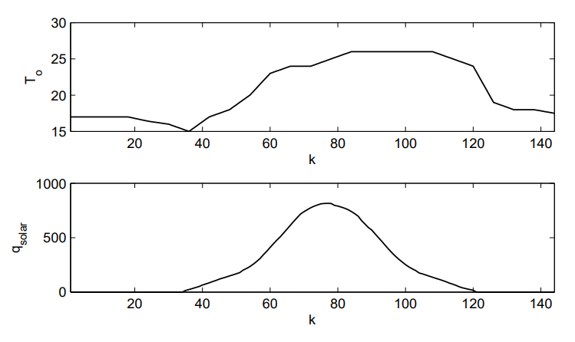
WEATHER DATA
Fig. 6: Weather data [5]
Notes:
Using the Euler discretization with a sampling time of $Δ$t we get

Slide 17
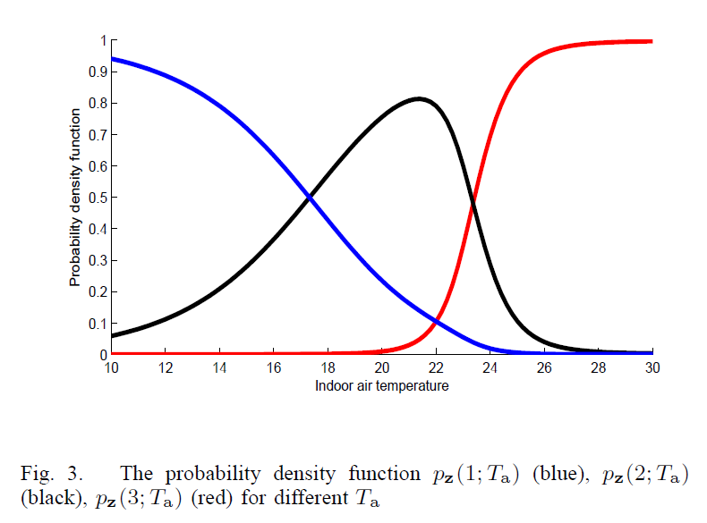
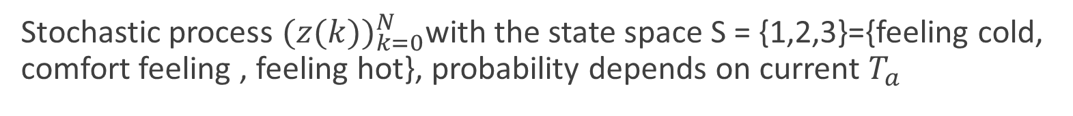
Probability density functions
Stochastic process ${(z(k))}_{k=0}^{N}$with the state space S = {1,2,3}={feeling cold, comfort feeling , feeling hot}, probability depends on current $T_{a}$
Fig. 7. The probability density function $p_{z}(1;T_{a})$ (blue), $p_{z}(2;T_{a})$ (black), $p_{z}(3;T_{a})$ (red) for different $T_{a}$ [5]
Notes:
Its probability depends on the current indoor temperature

Slide 18
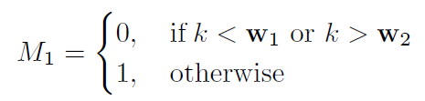
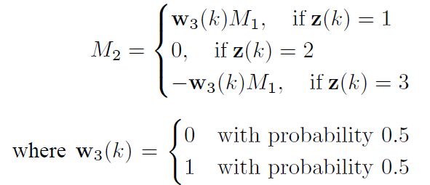
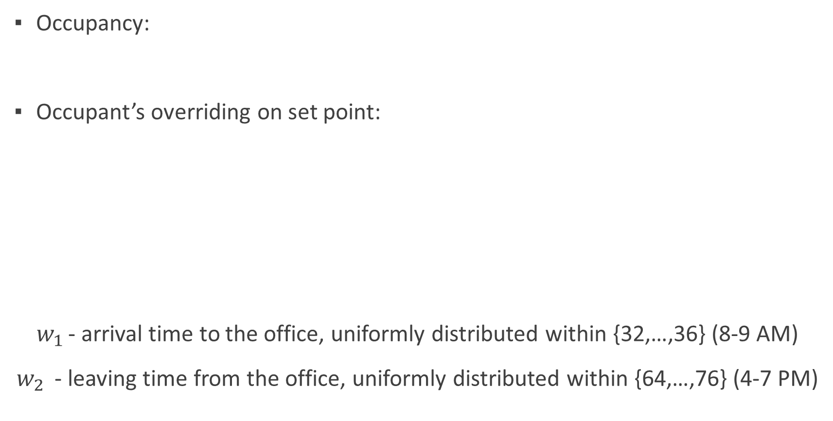
The occupant’s actions
Occupancy:
Occupant’s overriding on set point:
$w_{1 }$- arrival time to the office, uniformly distributed within {32,…,36} (8-9 AM)
$w_{2 }$ - leaving time from the office, uniformly distributed within {64,…,76} (4-7 PM)

Slide 19
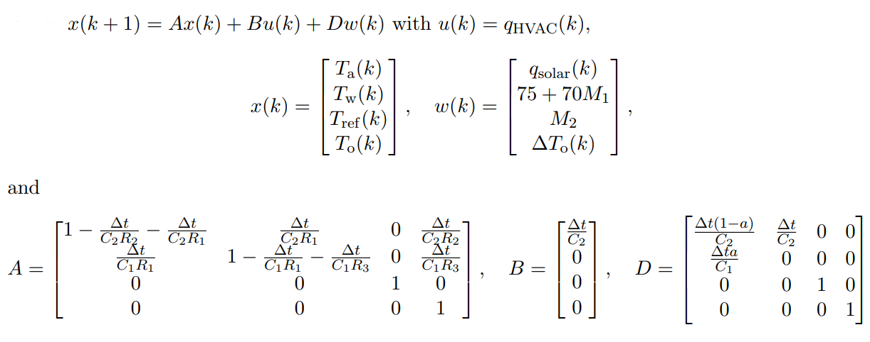
State-space model

Slide 20
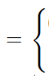
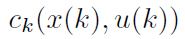
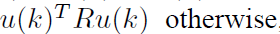
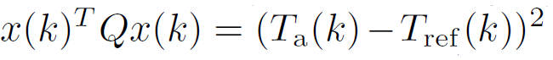
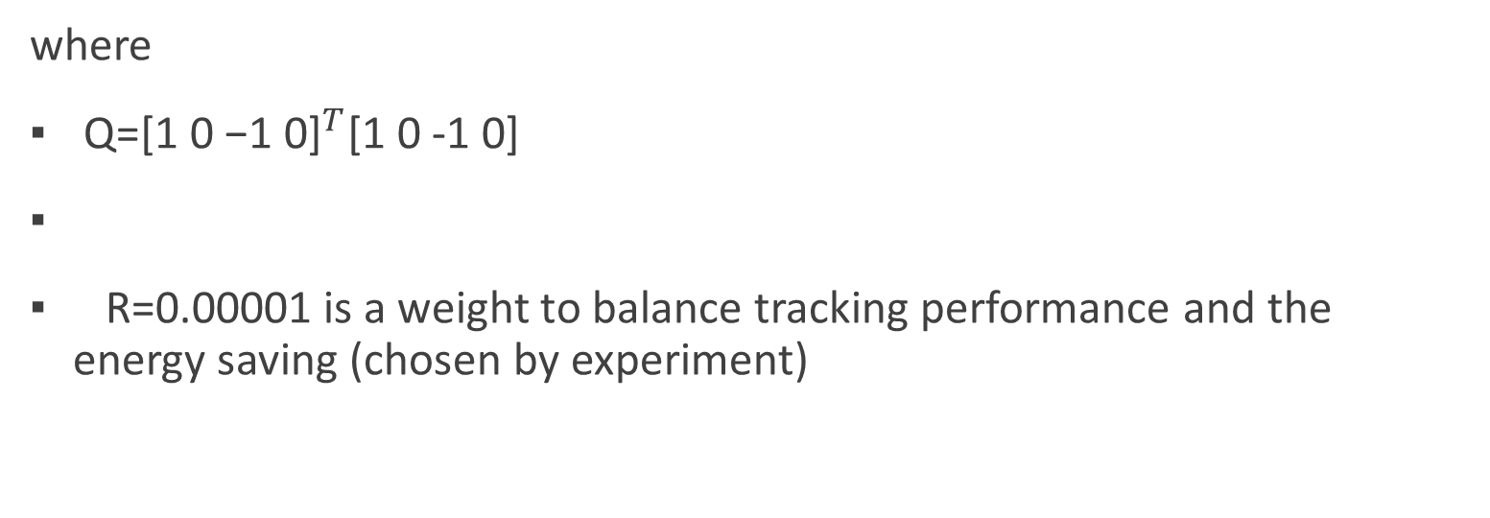
Cost function
where
Q=${\text{[1 0 −1 0]}}^{T}$[1 0 -1 0]
R=0.00001 is a weight to balance tracking performance and the energy saving (chosen by experiment)

Slide 21
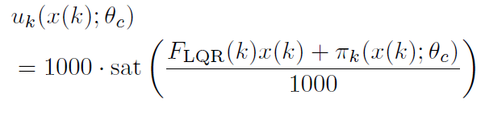
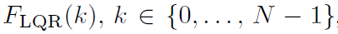
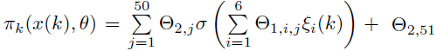
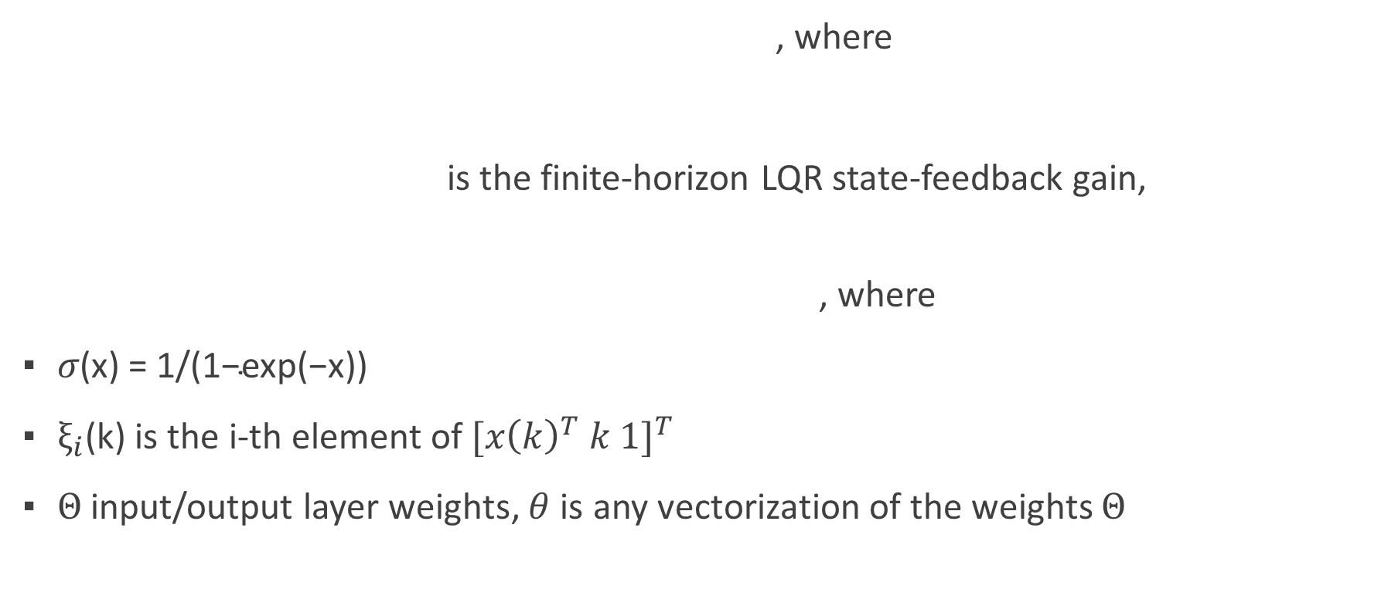
Parameterized control policy
, where
is the finite-horizon LQR state-feedback gain,
, where
${σ\text{(}\text{x}\text{) = 1/(1−}\text{exp}\text{(−}\text{x}\text{))}}_{ }$
$ξ_{i}\text{(}\text{k}\text{)}$ is the i-th element of ${[{x\left(k\right)}^{T} k 1]}^{T}$
$Θ$input/output layer weights, $θ$ is any vectorization of the weights $Θ$

Slide 22
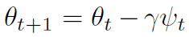

STABILIZING ALGORITHM $β−ASOCP$
To improve the stability of Algorithm 1, heuristic modification was applied:

Slide 23
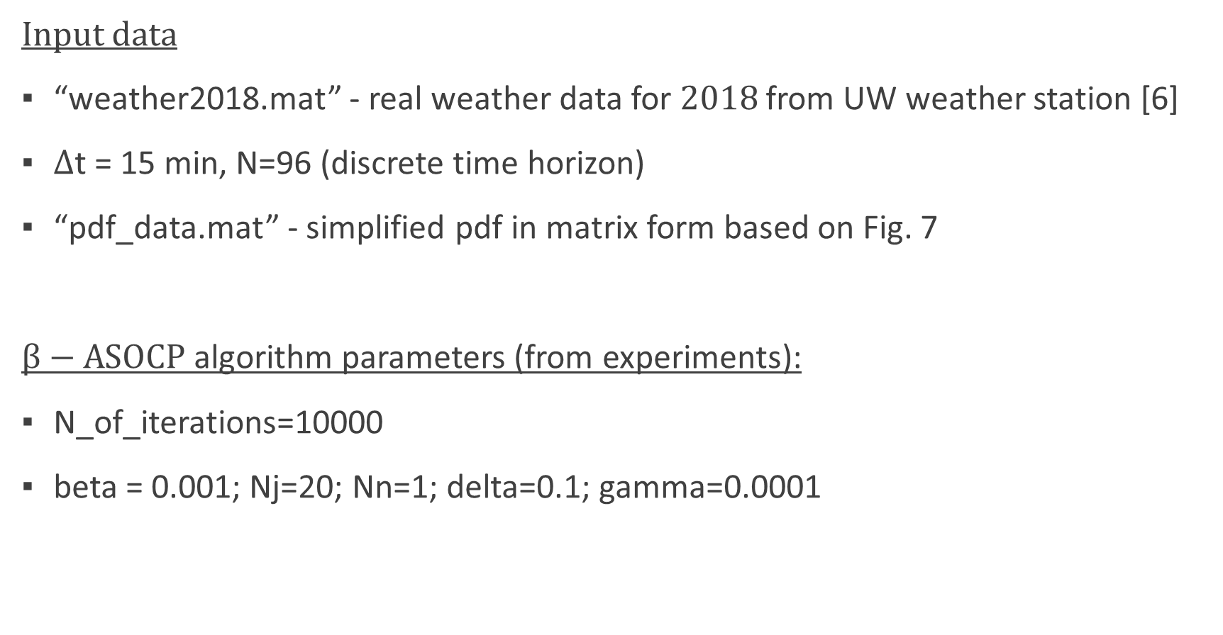
IMPLEMENTATION in matlab
Input data
“weather2018.mat” - real weather data for $2018$from UW weather station [6]
$Δ$t = 15 min, N=96 (discrete time horizon)
“pdf_data.mat” - simplified pdf in matrix form based on Fig. 7
$β−ASOCP$algorithm parameters (from experiments):
N_of_iterations=10000
beta = 0.001; Nj=20; Nn=1; delta=0.1; gamma=0.0001

Slide 24
IMPLEMENTATION in matlab
Functions
function [inp] = inputData(dayn)
loads pdf for user actions and weather data for a given day
initializes all parameters for dynamic state-space model
computes LQR state-feedback gain
function s = simulation(inp,w1,w2,weight1,weight2)
- 24h simulation (96 steps) for a given weights and day
function outputData(inp,x,u,z,M,method,cost,h,h_xlim)
- generates plots and histogram

Slide 25
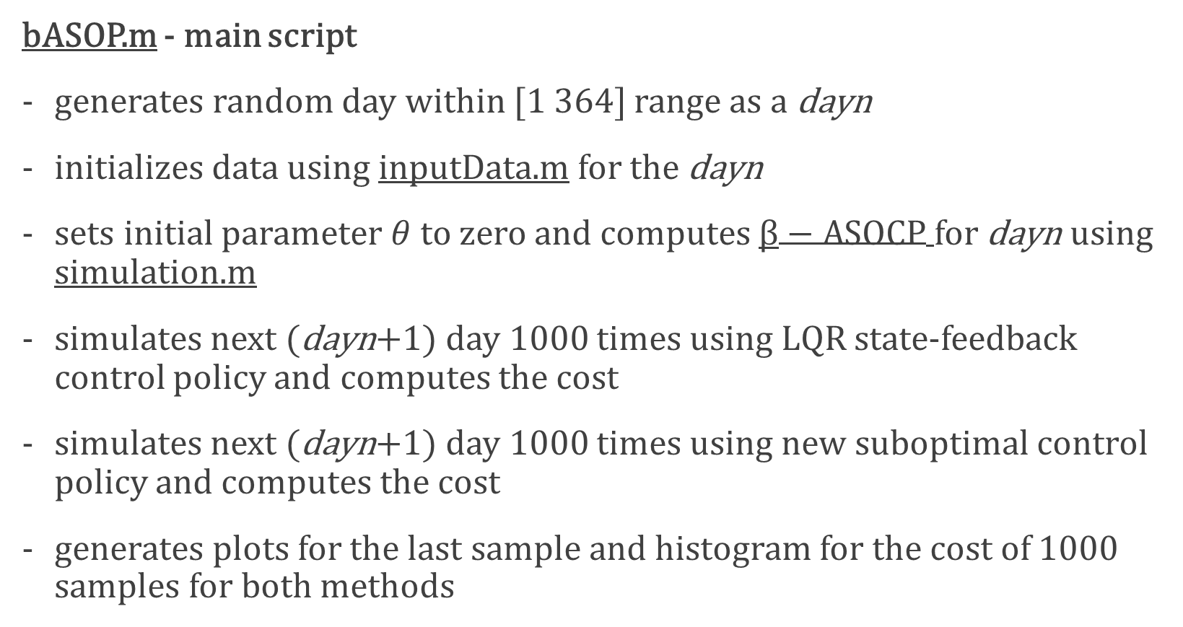
IMPLEMENTATION in matlab
bASOP.m - main script
generates random day within [1 364] range as a dayn
initializes data using inputData.m for the dayn
sets initial parameter $θ$ to zero and computes $β−ASOCP$for dayn using simulation.m
simulates next (dayn+1) day 1000 times using LQR state-feedback control policy and computes the cost
simulates next (dayn+1) day 1000 times using new suboptimal control policy and computes the cost
generates plots for the last sample and histogram for the cost of 1000 samples for both methods

Slide 26
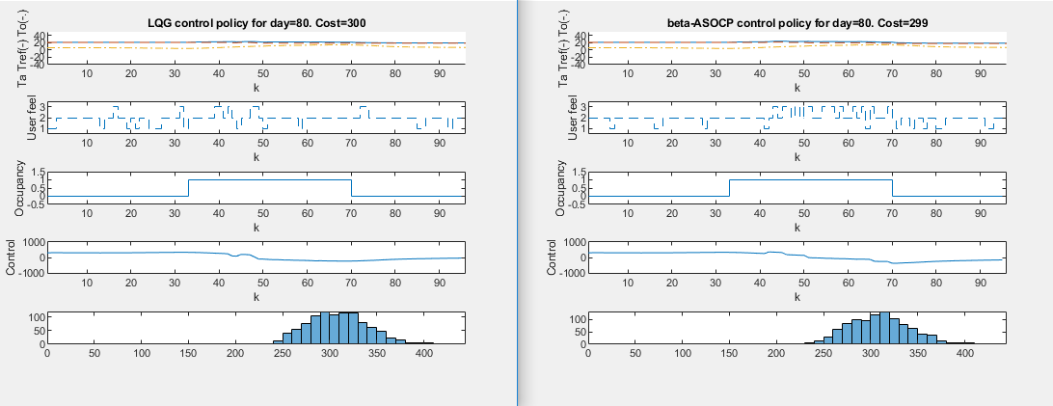
Simulation: N=1 (0.2 sec)

Slide 27
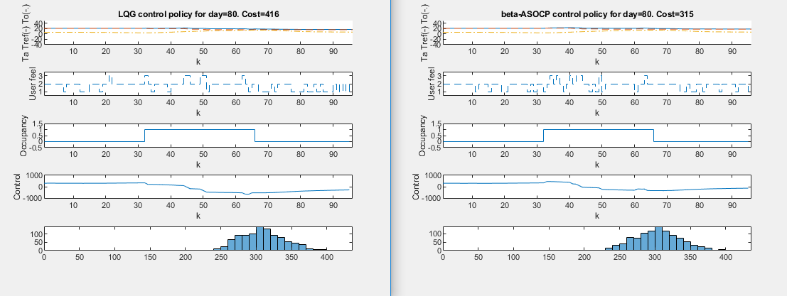
Simulation: N=10 (1.2 sec)

Slide 28
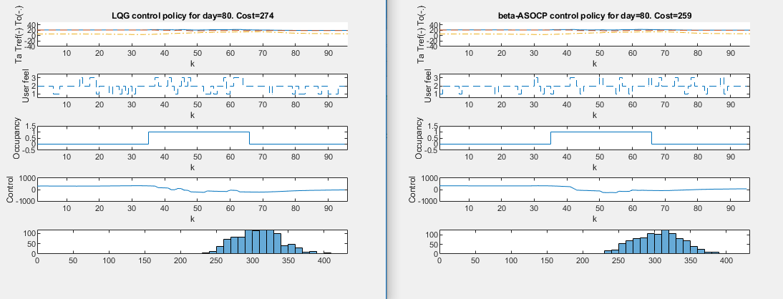
Simulation: N=100 (9.6 sec)

Slide 29
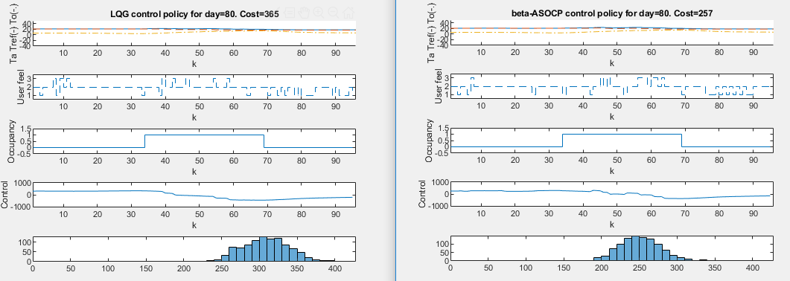
Simulation: N=1000 (~1.5 min)

Slide 30
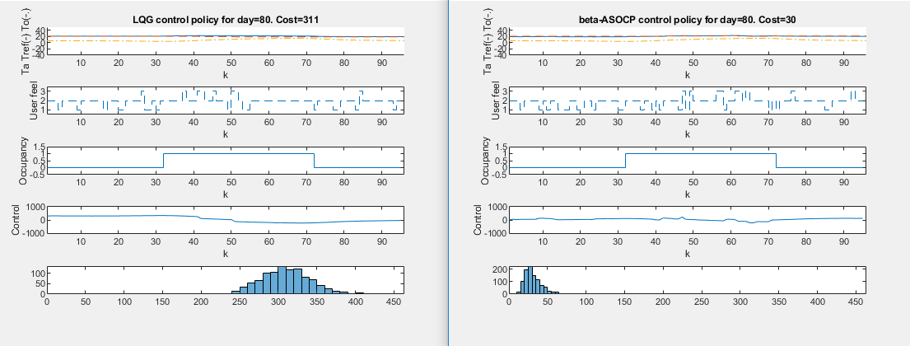
Simulation: N=10000 (~15min)

Slide 31

SIMULATION: 1 YEAR WITH N=10

Slide 32
CONCLUSIONS
Simulation-based policy gradient method can be applied to complicated stochastic systems that cannot be easily solved by existing methods.
Better results require longer computation time
New control policy uses data from the previous day, so can be computed in advance
Longer finite-horizon provides better discretization accuracy of SS model
Shorter finite-horizon provide better approximation of gradient

Slide 33
References
[1] [Electrical bill image]. (n.d.). Retrieved from https://news.energysage.com/is-your-electric-bill-too-high-heres-how-to-troubleshoot/
[2] [Temperature feeling image]. (n.d.). Retrieved from https://elhstalon.net/opinions/2015/10/09/youre-hot-and-youre-cold/
[3] [Weather image]. (n.d.). Retrieved from https://www.gmanetwork.com/news/scitech/science/612573/cities-may-be-8-degrees-celsius-hotter-by-2100-study/story/
[4] [Climate control image]. (n.d.). Retrieved from http://climatecontrolme.com/2012/04/control/
[5] UW weather station website http://weather.uwaterloo.ca/data.html
[6] Lee, Donghwan ; Lee, Seungjae ; Karava, Panagiota ; Hu, Jianghai “Simulation-Based Policy Gradient and Its Building Control Application” 2018 Annual American Control Conference (ACC), June 2018, pp.5424-5429

Slide 34
THANK YOU! ANY QUESTIONS?

